Slide 1
Sirius Secure Subsys Review
IP Owner: Hao Sun

Slide 2
Secure subsystem
Introduction
tRoot
SPACC(Security Protocol Accelerator)
PKA(Public Key Accelerator)
TRNG(True Random Number Generator)

Slide 3
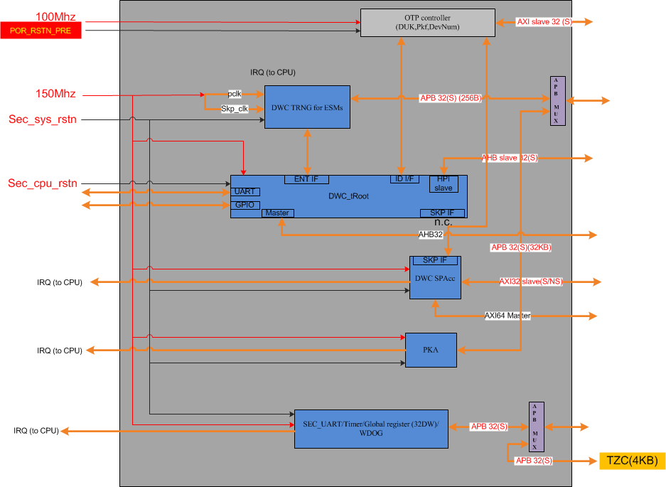
Introduction

Slide 4
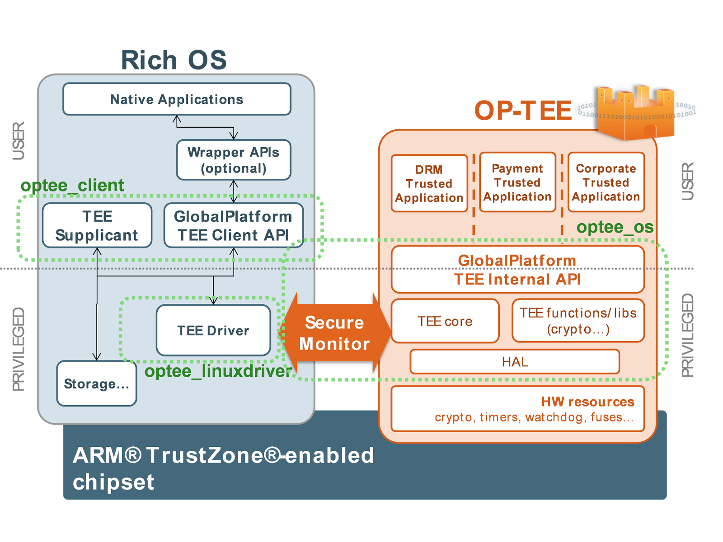
Introduction

Slide 5
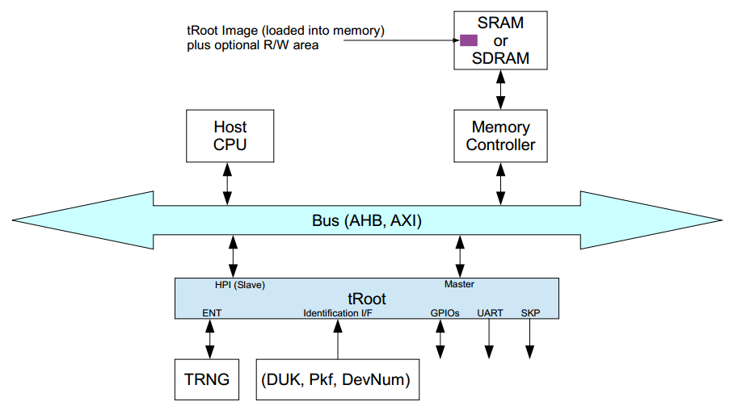
tRoot
Rom code
1.load
bootloader
tRoot Firmware
2. Verify
signature
3.load

Slide 6
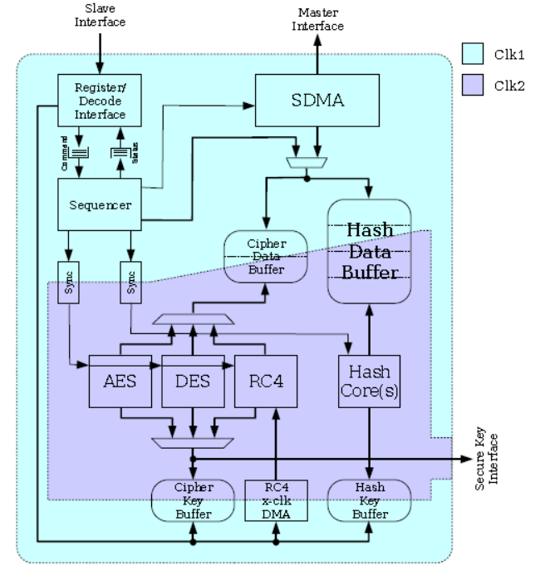
SPACC(Security Protocol Accelerator)

Slide 7

SPACC(Security Protocol Accelerator)
Platform id As IV
Emmc Cid As IV
Intermediate
key
SPAcc
AES256
SPAcc
AES256
OTP root key[idx]
Derived key
String1
“SecureStore” e.g
String2
“Artosyn” e.g

Slide 8
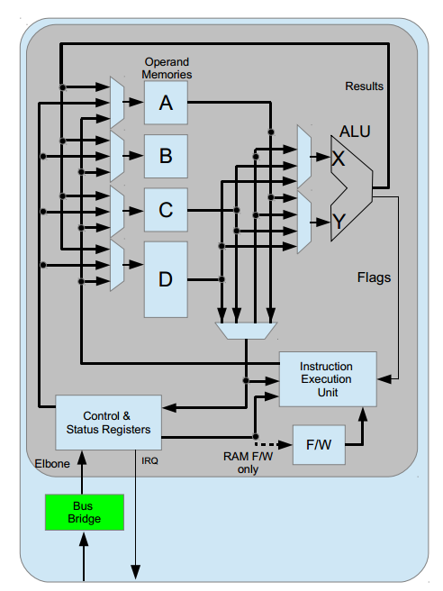
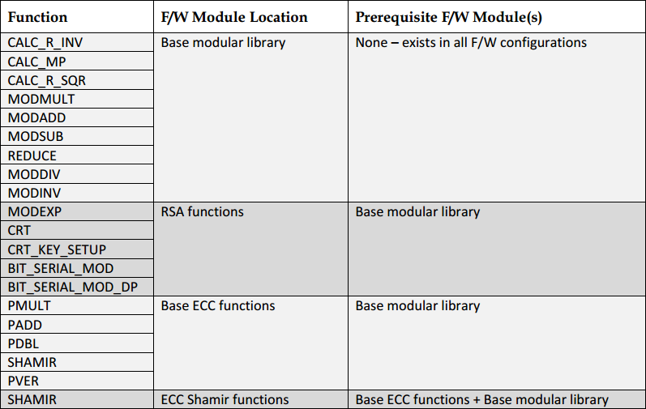
PKA(Public Key Accelerator)

Slide 9
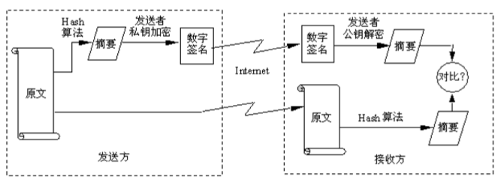
PKA(Public Key Accelerator)
Symmetric | ECC | RSA
80 | 163 | 1024
112 | 233 | 2240
128 | 283 | 3072
192 | 409 | 7680
 | Verify | Sign
RSA-1024 | 12 us | 511 us
RSA-2048 | 30 us | 3270 us
ECDSA-192 | 590 us | 490 us

Slide 10
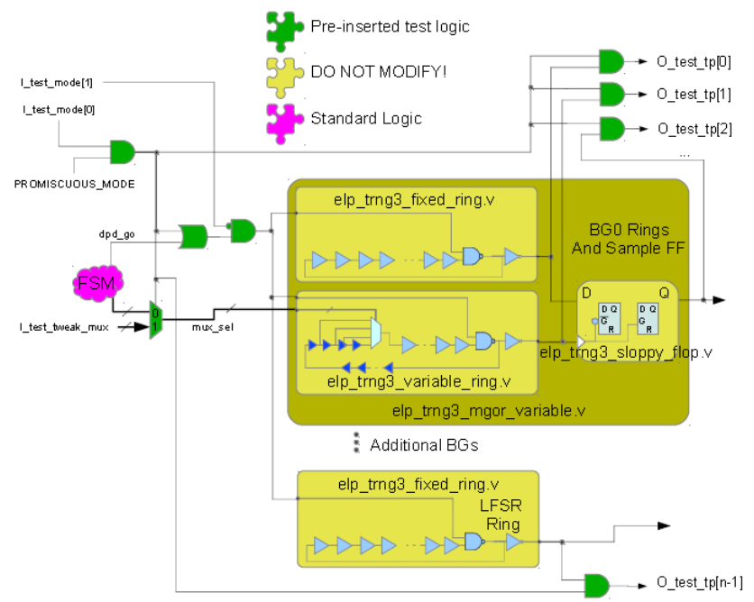
TRNG(True Random Number Generator)

Slide 11
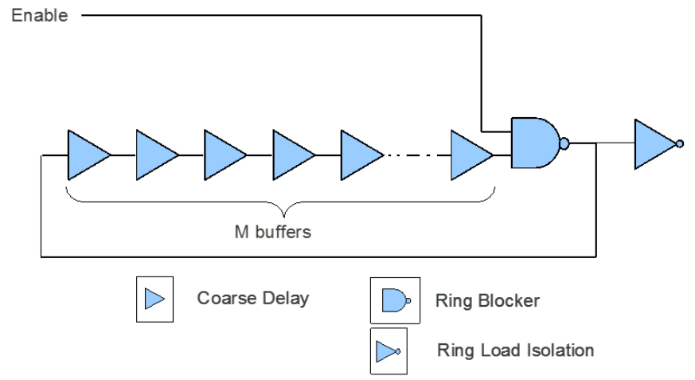
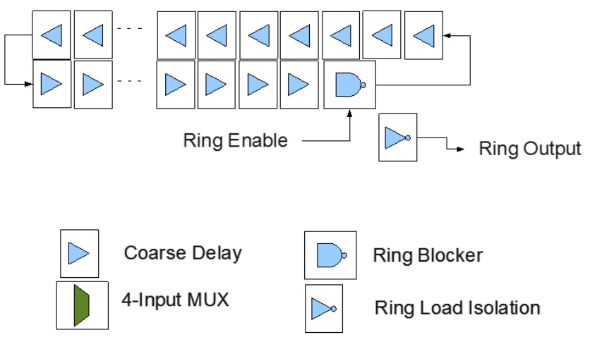
TRNG(True Random Number Generator)

Slide 12
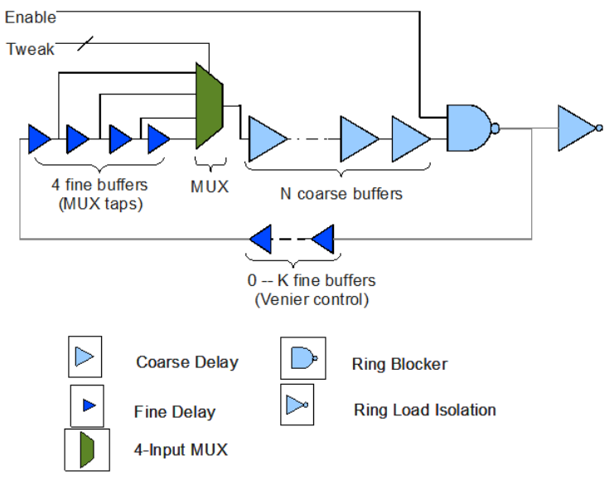
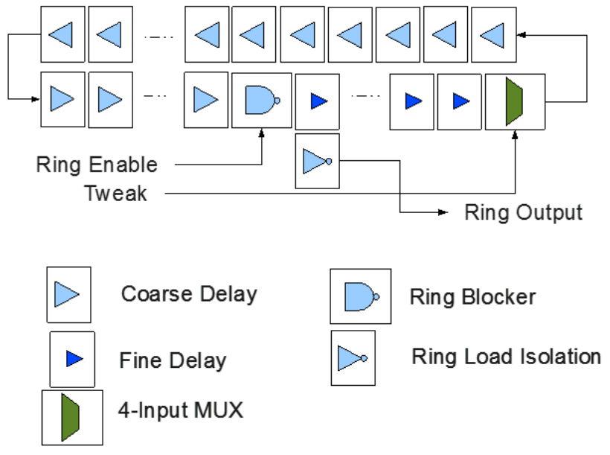
TRNG(True Random Number Generator)

Slide 13
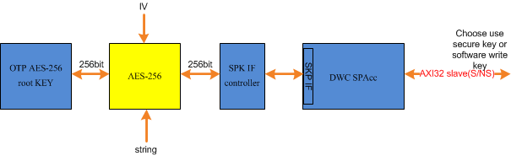
Improvement
Platform id As IV
Emmc Cid As IV
Intermediate
key
SPAcc
AES256
SPAcc
AES256
OTP root key[idx]
Derived key
String1
“SecureStore” e.g
String2
“Artosyn” e.g

Slide 14
Thank You

